Slide 1
Speech Perception

Slide 2
Speech Perception
Question: What distinguishes human language from the way other animals communicate?
The fundamental unit of speech is the Phoneme: A sound difference that affects the meaning of an utterance.
Consider the “n” in the word pronounced “win”, versus the word pronounced “winnnnn”.
Although you can hear the difference, the extended “n” sound does not change the meaning. So the extended “n” sound is NOT a phonemic difference.
By contrast, the difference between “win” and “wind” is a phonemic difference, since the meaning of those two utterances is different.
Native English speakers typically produce 12 phonemes per second, and can comprehend up to 50 phonemes per second.

Slide 3
Speech Perception
Unlike pure tones, a phoneme comprises many different frequencies.
Phonemes, and all other sounds, can be characterized by a Spectrogram: A plot showing how much acoustic energy is present at each frequency across time.
Let’s see the spectrogram associated with the spoken word “spike”…

Slide 4
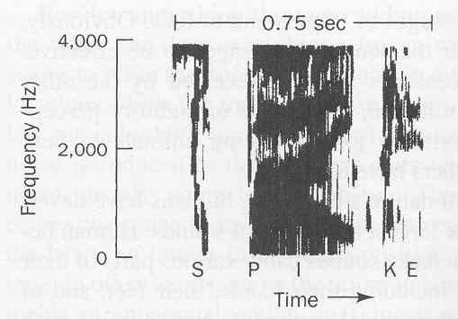
Speech Perception
The degree of darkness is proportional to the amount of energy.
In colored spectrograms, red=high energy: blue = low energy.
The same red/blue convention is used in MRI & PET scans.

Slide 5
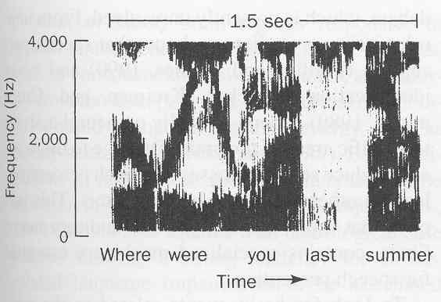
Speech Perception
Which word is most emphasized here?
Note: In everyday life, shifts in acoustic energy
affect the connotation of the sentence!

Slide 6
Speech Perception
There is a correspondence between the ordinate of the spectrogram (which indicates frequency), and the activity of the basilar membrane (which performs a frequency analysis on incoming sounds)…

Slide 7
Speech Perception
Which end of the ordinate is “apical” and which is “base”?

Slide 8
Speech Perception
Although the spectral content (i.e., the amplitude at each frequency range) provides cues about speech sounds, a difference in spectral content does not necessarily generate a difference in the perceived speech sound.
That is, a given speech sound can have more than one “image” in spectrograms.
For example, the spectrogram reveals that the /d/ sound rises in the syllable /di/, but falls in syllable /du/…

Slide 9
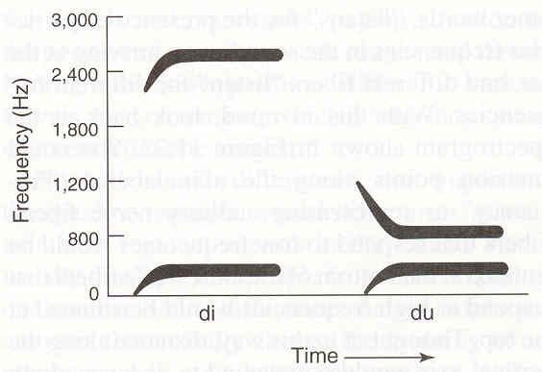
Speech Perception
The /d/ can rise or fall, depending on the vowel sound.

Slide 10
Speech Perception
The rises and dips are called formant transitions.

Slide 11
Speech Perception
Formant transitions are cues to consonants…

Slide 12
Speech Perception
Formants
Formants
The vowel-related horizontal bands are called formants.
Formants are amplitude peaks in the frequency spectrum.

Slide 13
Speech Perception
Let’s see how the formants make vowels distinct from each other. We’ll see spectrograms in which the consonants (i.e., the formant transitions) have been eliminated…

Slide 14
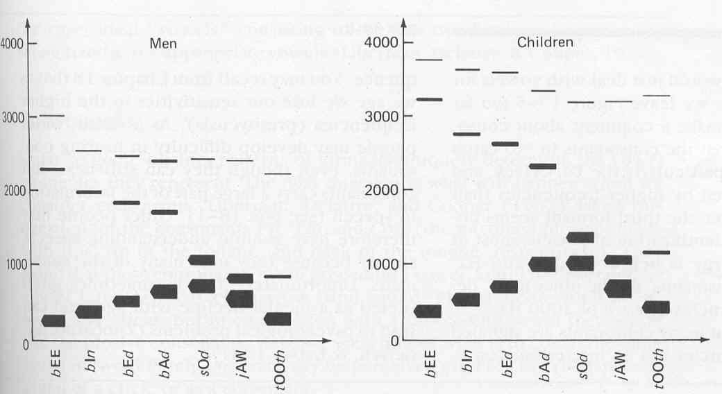
Speech Perception
Vowels are distinguished by formants.

Slide 15
Speech Perception
Regional accents are determined by differences in vowel sounds.

Slide 16
Speech Perception
Columbia University linguist, Larry Heuer, claimed that
Californians have a reduced “phonetic space”: caught=cot.

Slide 17
Speech Perception
We hear different consonant sounds because we are sensitive to various aspects of formant transitions.
For example, for a given vowel sound, the “neighboring” consonant sounds could be distinguished by the duration of the formant transition..

Slide 18
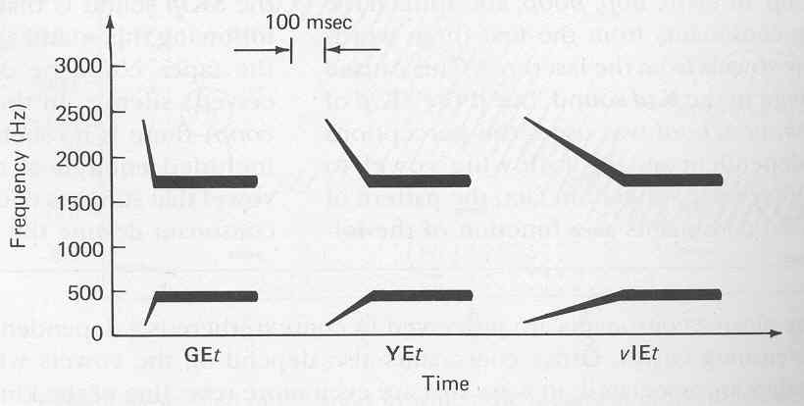
Speech Perception
Long
Brief
Consonants can be distinguished by the
duration of the formant transition.

Slide 19
Speech Perception
So, detecting subtle difference in the temporal structure of acoustic energy is critical for speech perception.
Some people lack this ability, and this creates a learning impairment….

Slide 20
Speech Perception
Language-Based Learning Impairment (LLI) - A limitation in language skills that arises from the inability to discriminate transient acoustic features associated with speech sounds.
LLI affects about 5% of children, most of whom have perfectly normal audibility functions (AF).
These children ‘can hear, but cannot understand’ speech as well as other children.
The auditory systems of children with LLI have lower-than-normal (more coarse) temporal resolution.
In LLI, events that are physically distinct and discriminable to most children become blended together in time.

